Slide 1
AWESOMENESS IN PROGRESS:
How Mississippi State University’s School Certifying Officials
Take Care of Their Students
Presented by: Melanie F. Owens, Yolanda B. Tate and Julie Kirk

Slide 2
What We’ll Discuss:
Population
In-Processing
Certification Procedures
Records Management
Additional Benefits

Slide 3
Our Population: Veterans, Dependents, Service Members & Survivors
MSU Total Population: 21,622
VSDS Total Population: 2,307
# of students using G.I. Bill®: 677
# of veterans/service members: 293
# of dependents: 384

Slide 4
In-Processing/Certification Requirements
Outreach Coordinator advises potential students and assists with admissions process.
Walk-ins
Collaborate with Admissions during Orientation
Once admitted, SCOs collect necessary paperwork for certification. Paperwork could include:
VONAPP
NOBE
DD-214, member 4 copy
Certificate of eligibility (COE)
MSU Verification of Enrollment form
22-1999
22-1995/22-5495
Military transcript

Slide 5
Routine Certification Procedures
To ensure all students using G.I. Bill® are certified timely and correctly, these requirements have been implemented:
Priority registration: at least 5 days before regular registration
Account Hold: as a reminder that MSU Verification Form needs to be submitted
2-step certification process:
Report hours for all G.I. Bill® chapters prior to start of semester
Report Tuition & Fees for CH 33s after last day to add a class (determined by MSU)

Slide 6
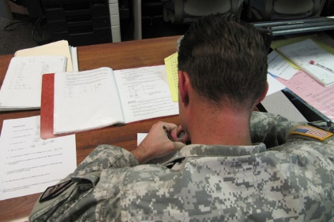
Why can’t I request for more than 16 credit hours?
What is FTA? Why can’t I use GI Bill® and FTA at the same time?
Which one should I use? Where is my FTA money?
What we share with students eligible for both GI Bill® and FTA

Slide 7
GI Bill® Only | FTA Only
Have enough financial aid to cover your tuition? Need GI Bill® benefits that are sent directly to you? GI Bill® Funds are sent directly to you. Request GI Bill® | FTA funds are sent directly to the school. Not enough financial aid to cover your tuition? Do not need GI Bill® benefits that are sent directly to you? Request FTA
GI Bill® and FTA
GI Bill® funds are sent directly to you FTA funds are sent directly to the school. You may use consecutively but not concurrently.

Slide 8
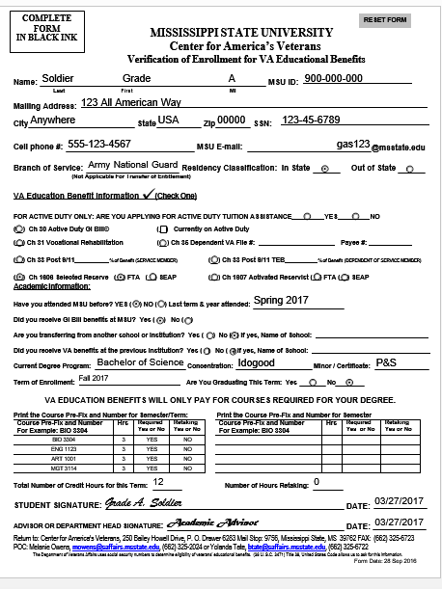
Verification of Enrollment
Chapter 1606/1607 may select
FTA or SEAP
Provides SCO a “Heads Up”
To prevent “double dipping”

Slide 9
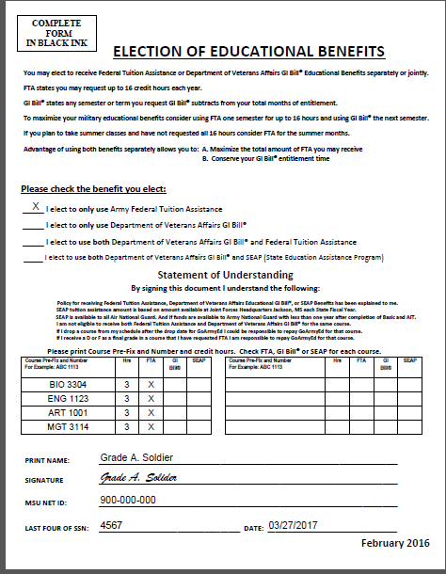
Election of Educational Benefits
Further explains FTA or SEAP option
Allows Service-Member to elect
their best choice plus providing
“Double dipping” avoided

Slide 10
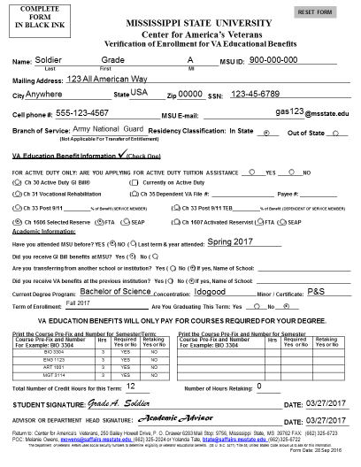
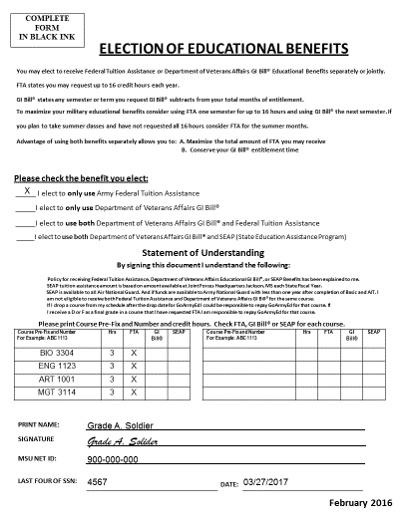
BLUF…..How does it help the service-member and school certifying official?
Win-Win for both the service-member and the School Certifying Official
Shows the service-member in black and white their options are….
Less stress for the service-member plus less errors for the SCO in certifying enrollment

Slide 11
Records Management
To stay in compliance with the policy on reporting changes within 30 days, we have implemented procedures that help…
Word of mouth: if students are changing their hours, we encourage them to call us, so we can make the necessary changes.
Banner Reports: reports are ran periodically to help catch changes in hours, withdrawals, and changes in tuition & fees.
After last add day, we are notified via emails from ITS of any changes made by students to schedules.
All 1999s, add/drop slips, and other course related materials are maintained in student files by semester.

Slide 12
Additional Benefits
Out of state tuition waiver
Center for America’s Veterans Scholarships
Mobilization Assistance: Student has 3 options
Withdraw with full refund (no grade)
Leave after ¾ term, take the final within 90 days of return or if possible while deployed in independent study (decided by individual and professor)
Leave after the ¾ term mark, the student can take their current grade
Active Duty Top Up

Slide 13
Green Zone Training
3 part workshop designed to equip faculty, staff and other students with tools necessary to help veteran students transition into college environment
Military 101
Student panel
Mental health
3 hour training session offered each semester
Approximately 300 have taken advantage of training

Slide 14
THANK YOU!!! #HailState

