Slide 2
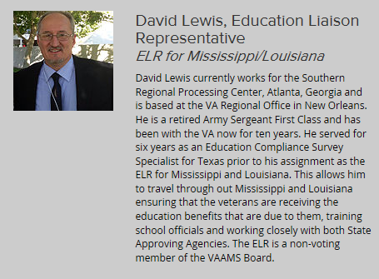

Slide 5
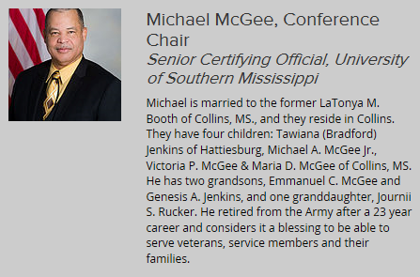

Slide 9
VA Acronyms
BDN
Benefits Delivery Network
CO or SCO
Certifying Official or School Certifying Official
COE
Certificate of Eligibility
DoD
Department of Defense
ECAP
Electronic Certification Automated Processing
ELR
Education Liaison Representative
IHL
Institute of Higher Learning

Slide 10
VA Acronyms Continued
LDA
Last Date Attended
LDCA
Last Date Credit Accrued
MGIB
Montgomery GI Bill® (Ch 30)
MGIB-SR
Montgomery GI Bill®- Selected Reserve and Guard (Ch 1606)
NCD
Non-College Degree
NOBE
Notice of Basic Eligibility
OLAF
On Line Approval File (old database – no longer used

Slide 11
VA Acronyms Continued
REAP
Reserve Education Assistance Program (Ch 1607)
REPS
Restored Entitlement Program for Survivors
RO
Regional Office
RPO
Regional Processing Office
SAA
State Approving Agency (State Approving Agent)
TA
Tuition Assistance Program (DoD program, not VA)
TATU
Tuition Assistance Top-Up
TIMS
The Image Management System (scans documents)

Slide 12
VA Acronyms Continued
VA or DVA
Department of Veterans Affairs
VA-ONCE
Internet based reporting system for Enrollments, changes, & Terminations
VEAP
Veterans’ Educational Assistance Program- Post Vietnam Era (Ch 32)
VONAPP
Veterans On-line Application
WAVE
Web Automated Verification of Enrollment
WAVES
Western Association of Veterans Education Specialists
WEAMS
Web Enabled Approval Management System (databased for approved programs)

