Slide 1
MSARNG Education Benefits Briefing
MAJ Chris R. Davis
PRESENTED BY:
MSARNG Education Services Branch
NGMS-PEF-E
(601) 313-6300

Slide 2
Overview
Transfer of Benefits (TEB)
Federal Tuition Assistance (FTA)
SEAP
How to apply for VA Benefits
Links and POCs

Slide 3
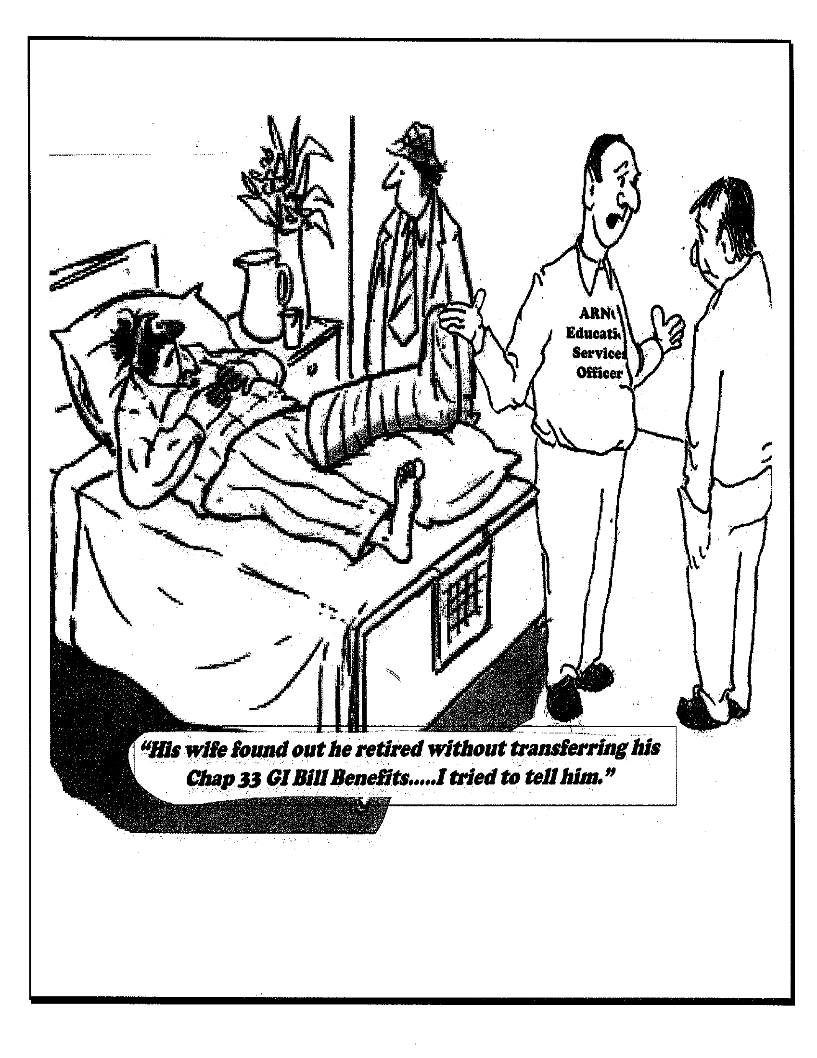
Transfer of Education Benefit (TEB)

Slide 4
Transfer of Education Benefit (TEB)
What Is It?
A GI Bill Program that allows Soldiers to transfer their Post-9/11 GI Bill benefits to spouses/dependents
How Do I Qualify?
Be in Armed Forces on or after 8/1/09, and
Have completed at least 6 years in the Armed Forces, and
Not have an adverse action flag, and
Agree to serve 4 years from initial date of transfer request
*Must initiate transfer of benefits while serving in the Armed Forces
*After retiring or separating, can revoke or modify only existing transferred benefits

Slide 5
Transfer of Education Benefit (TEB)
What Do I Get?
May transfer up to 36 total months of benefits to spouse, child or children (determined by number of months of eligibility for which you qualify)
DEERs Eligible Dependents;
Spouse (no age restrictions)
Can use immediately after receiving approved TEB
Children
Must be under the age of 23 to receive transferred benefit months
Can use after SM has served at least 10 years in the Armed Forces
Can use as early as age 18 (or receipt of high school completion equivalent cert.)
Prior to age 26 or until months are exhausted (whichever comes first)

Slide 6
Federal Tuition Assistance (GoArmyEd)
What Is It?
Financial assistance to help Soldiers in their educational pursuits
How Does a Soldier Qualify?
Served 1 year AFTER AIT/BOLC completion
Not flagged or pending unfavorable action
College must be accredited and participating in GoArmyEd
Officers incur a service obligation
(2 years for Active Duty/AGR, 4 years for RC)
Must have completed 10 years of service to use FTA for a Masters Degree (if previously used FTA)

Slide 7
Federal Tuition Assistance (GoArmyEd)
What Does a Soldier Receive?
100% of tuition cost up to $250 per semester hr ($167 per quarter hr, or $5.55 per clock hr)
Up to 16 semester hours per fiscal year (1 October – 30 September)
Fees no longer authorized for payment
Authorized Uses:
Pursuit of a Certificate, Associate, Bachelor, or Master’s Degrees
FTA will not pay for a second (duplicate) or lower degree or credential in any of these categories, regardless of the funding used for the first degree or credential

Slide 8
Federal Tuition Assistance (GoArmyEd)
Career limits for FTA are:
130 semester hours at the Bachelor’s/Undergraduate level
39 semester hours at the Master’s level
21 semester hours at the Certificate level
Duplication of Benefits:
Federal Tuition Assistance and MGIB-SR/REAP (Ch’s 1606/1607) are not authorized for the same course at the same time
How to Apply: Go to www.goarmyed.com
(select student at the Create/Activate GoArmyEd Account log-in)
When creating a GoArmyEd account, DO NOT use an AKO email address
List a good contact phone number

Slide 9
Federal Tuition Assistance (GoArmyEd)
GoArmyEd Contact Information:
Soldiers need to check and make sure their preferred email address and contact information in GoArmyEd are correct. Soldiers that are using an AKO account as their preferred email address MUST change their preferred email to a mail.mil account or a civilian email address.
Soldiers who fail to change their preferred email address from an AKO email in GoArmyEd WILL NOT receive the latest GoArmyEd information or receive the approval status of their TA requests.
Recoupment
Undergraduate students are required to maintain a 2.0 GPA in order to receive tuition assistance. Courses that have a grade of "D" or below will be recouped.
Graduate students are required to maintain a 3.0 GPA in order to receive tuition assistance. Courses that have a grade of "C" or below will be recouped.

Slide 10
Federal Tuition Assistance (GoArmyEd)
)
When to Submit Tuition Assistance Requests:
All GoArmyEd TA REQUESTS MUST BE APPROVED PRIOR TO THE COURSE START DATE. Courses not approved prior to the course start date will be self-funded. Soldiers may input their TA requests up to 60 days PRIOR, but no later than 10 days BEFORE the course start date. Input TA requests as SOON AS POSSIBLE!
For example, if a course begins on 8 May, Soldiers can input your tuition assistance request as early as 9 March, but NO LATER THAN 28 April. TA requests are processed on a FIRST-COME, FIRST-SERVED basis. If Soldiers wait until the last minute to request tuition assistance, there's no guarantee their TA will be approved.

Slide 11
Federal Tuition Assistance (GoArmyEd)
GoArmyEd Reminders:
All enrollments, drops and withdrawals must be done through the GoArmyEd portal, and failure to do so will result in the student being held financially responsible for the course(s).
Upload ALL documents to eFile in PDF format. Print out the document. Scan it. Save to desktop as a PDF document. Upload to eFile. Ensure you use correct transaction type.
Course Planner: Upload official degree plan from school to eFile and input remaining courses required for degree. A page out of the school catalog will not suffice. Input Course Planner as soon as possible.
Detailed Bill and Schedule: The bill must specify Tuition = X amount of dollars. A page out of the school catalog will not suffice. The schedule with student’s name must show all courses with the START and END dates, course department and numbers, course names, course hours and days/times for each class.

Slide 12
Federal Tuition Assistance (GoArmyEd)
HELPFUL INFO FOR SCHOOL POCs
From GoArmyEd home page:
Click on Reference Documents.
Select a Reference Document Category: Non-LOI Training
Click on the document that addresses your questions, such as step-by-step instructions to:
a. Creating a Non-LOI School GoArmyEd Account
b. Step-by-Step Instructions to Enter Grades
c. Getting Started – Invoice Administrator
d. Removing a Class from an Invoice
e. Etc.

Slide 13
Federal Tuition Assistance (GoArmyEd)
HELPFUL INFO FOR SCHOOL POCs
From GoArmyEd home page:
Click on Training.
Select the training you need.
a. LOI School Training
b. Non-LOI Training

Slide 14
Federal Tuition Assistance (GoArmyEd)
GoArmyEd Help:
If you need GoArmyEd assistance, please go to the top of any GoArmyEd web page and select the Green question mark and select the link titled "GoArmyEd Assistance Center." You can then enter the topic or category in the search fields. If you still can't resolve your questions and need to create a help desk case, select the "helpdesk" tab at www.GoArmyEd.com or call 1-800-817-9990.

Slide 15
State Education Assistance Program
(SEAP)
What is SEAP?
Provides tuition assistance up to $4,500 for Soldiers not yet eligible to receive Federal Tuition Assistance (GoArmyEd)
Will pay on a first-come, first-served basis per State fiscal year for Mississippi Public Colleges and Universities
Cannot be used for graduate level courses
Once Soldier has served one year after AIT/BOLC completion, no longer eligible for SEAP
How do I Qualify?
Basic Training Graduate
Not eligible for Federal Tuition Assistance
Registered voter in the State of Mississippi
Actively serving in good standing
Attending a Mississippi Public College or University
Maintain a 2.0 GPA
Apply through Mississippi Education Office

Slide 16
How to Apply for VA Benefits
Apply On Line at VONAPP: http://vabenefits.vba.va.gov/vonapp/main.asp
Information Needed
School address and VA representative’s phone number
Personal Information (Address, Phone, etc…)
Bank account routing number and account number
Supporting Documents
DD214 and/or Orders (mobilization, Temporary Change of Station (TCS), Title 10 ADOS, Title 10 AGR, Title 32 AGR)
Ensure all orders/DD 214s and current NGB 23 are placed in your iPERMS
Scan/upload documents (preferred) or mail to the VA
Dependents should send in Sponsors supporting documents with their application
For VA Education Support, Call 1-888-442-4551

Slide 17
Helpful Websites
GI Bill Program: http://www.gibill.va.gov
Federal Tuition Assistance: http://www.goarmyed.com
Tuition Assistance DECIDE: http://www.dodmou.com/TADECIDE/
CLEP Exam: http://clep.collegeboard.org
Credentialing Opportunities Online: https://www.cool.army.mil
TEB Request: https://www.dmdc.osd.mil/milconnect
eBenefits: https://www.ebenefits.va.gov
Joint Service Transcripts: https://jst.doded.mil/smart

Slide 18
Contacts
MAJ Christopher R. Davis, Education Services Officer 601-313-6183
christopher.r.davis5.mil@mail.mil
SSG Adrian Young, Education Services, NCOIC 601-313-6178
adrian.s.young.civ@mail.mil
Dr. Cortney R. Harris, State GI Bill Manager 601-313-6355
cortney.r.harris.civ@mail.mil
Ms. Penny Boggan, State Education Assistance Program (SEAP) 601-313-6248
penny.w.boggan.nfg@mail.mil
Mr. David Jolly, LTC(Ret) GoArmyEd, FTA Manager 601-313-6442
david.f.jolly2.civ@mail.mil

Slide 19
QUESTIONS

