Slide 1
Department of Veterans Affairs
Debt Management Center
(DMC)
School Certifying Officials Workshop Presentation

Slide 2
Overview
About DMC
Debt Establishment
The Collection Process
Making Payment to DMC
The Treasury Offset Program (TOP)
FAQ

Slide 3
About DMC

Slide 4

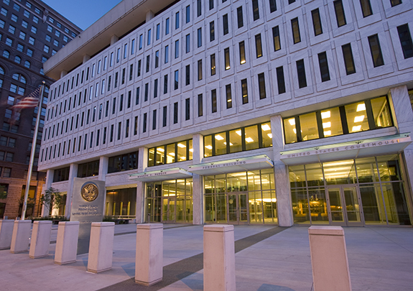
DMC Mission Statement
The Debt Management Center provides distinctive, high quality accounts receivable services through a compassionate and value-added approach, empowering our stakeholders to focus on core missions.
Bishop Henry Whipple Federal Building
Warren Burger Federal Building

Slide 5
DMC Notes
  Debt Management Center (DMC) was established in July 1991.
  We are located with the VA Regional Office in St. Paul, MN.
    Satellite office in Warren Burger Federal Courthouse downtown St. Paul
  We provide debt collection services:
    Veterans Benefits Administration (VBA)
      Compensation
      Pension
      Vocational Rehabilitation
      Education
      Home Loan Guaranty
    Veterans Health Administration (VHA)
      First party medical
    National Cemetery Administration (NCA)
  We service approximately 600,000 accounts and collect $1.5 billion annually.
  Staff of approximately 250 employees; 40% are Veterans
    FY17 projected growth to 275 FTE

Slide 6
Debt Establishment

Slide 7
The 7 Reasons A School Debt (75B) Is Established
Student never attended classes
Student completely withdrew on or before the first day
Student passed away during or before the term started
School received a payment for the wrong student
School received a duplicate payment
School submitted an amended certification to report reduced tuition and fee charges and/or Yellow Ribbon
VA issued payment above the amount certified
Notes:
If a student reduced but not completely withdrew, the debt shall be assessed to the student.

Slide 8
The Collection Process

Slide 9
The Collection Process
DMC Sends 1st NOI
30 days
DMC Sends 2nd NOI
30 days
DMC Sends 3rd NOI
60 days
Debt is Referred to TOP
Notes:
DMC sends three Notice of Indebtedness letters over a period of sixty days. These letters all provide information regarding:
Where to send payment, including return envelope and payment remittance stub
E-mail address: dmcedu.vbaspl@va.gov
Toll-free number for DMC: 1-800-827-0648
After the third collection letter is sent, if payment is not received and applied within 60 days, the account will be referred to the U.S. Department of Treasury, Treasury Offset Program (TOP). In other words, if a debt is still unpaid 120 days after the first Notice of Indebtedness is sent, it will be referred to TOP.

Slide 10
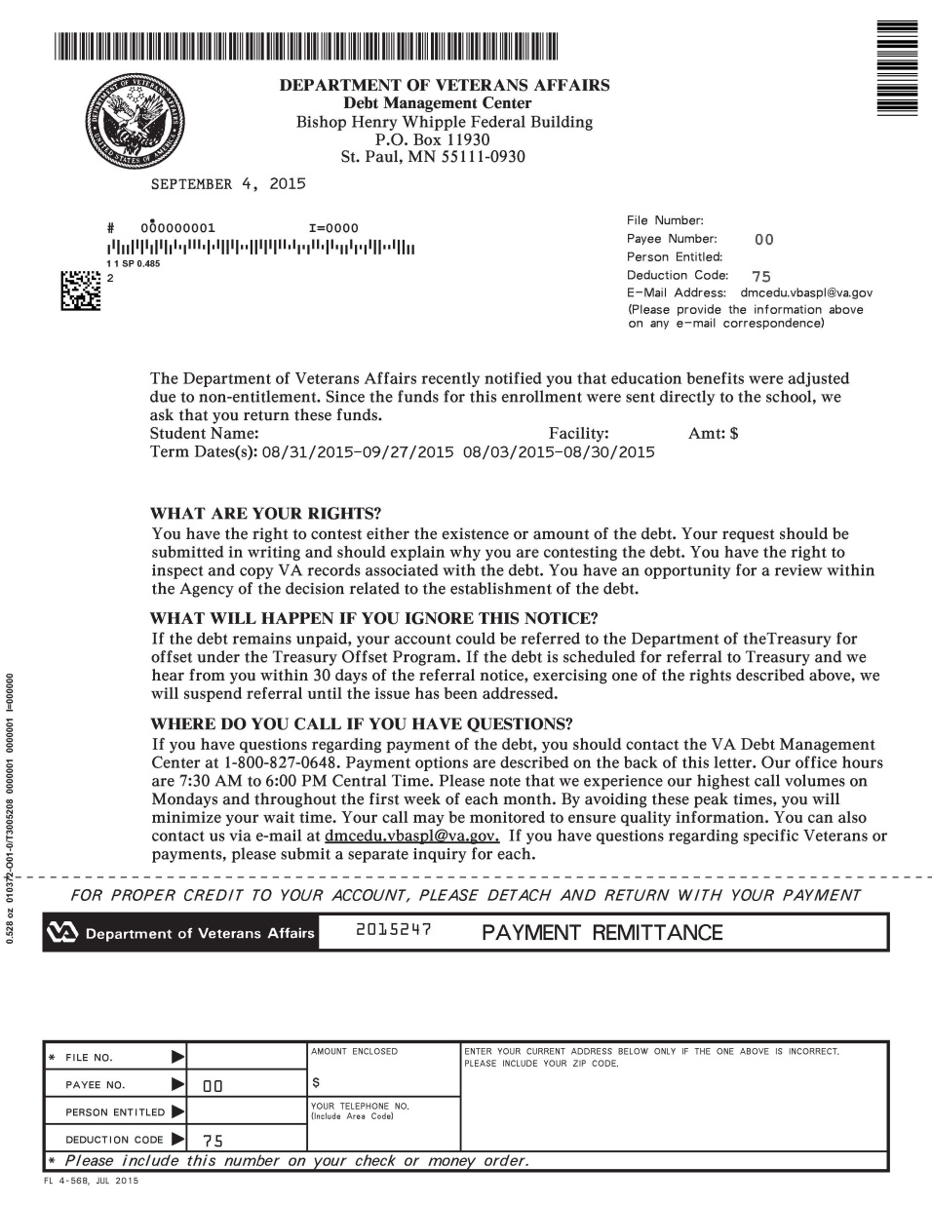
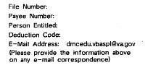
First Notification Letter
Notes:
Letters are mailed to address on file with the Web Enabled Approval Management System (WEAMS) system used by State Approving Agencies and VA.

Slide 11
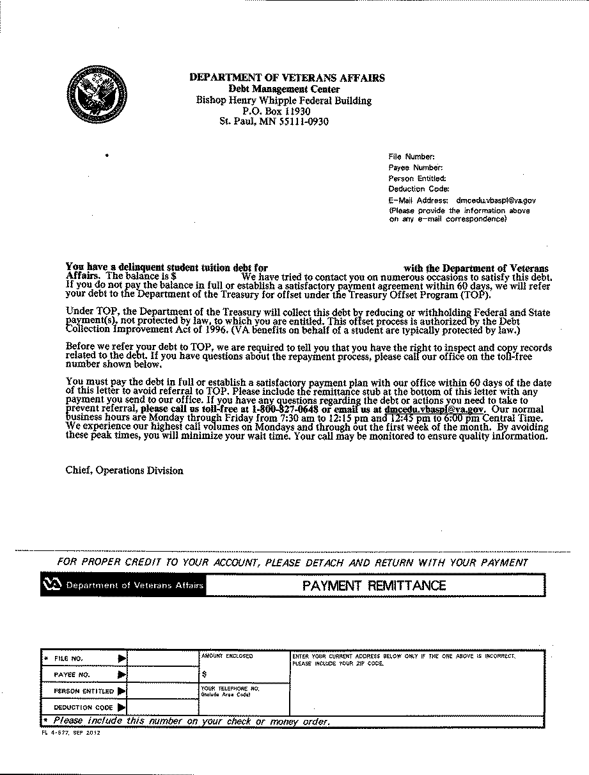
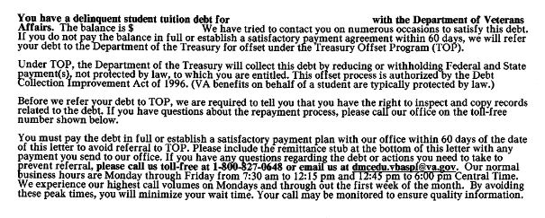
Third Notification Letter

Slide 12
Making Payment to DMC

Slide 13
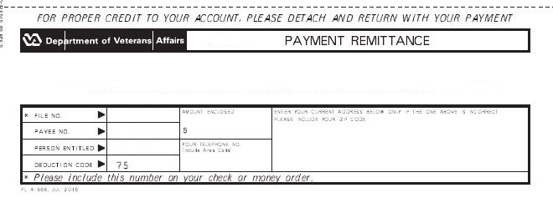
Helpful Tips
Make sure a debt has been established before sending funds to DMC
Sending a payment without verifying that a debt exists or including the payment stub from the DMC letter, will delay application of your payment

Slide 14
Making Payment to DMC
Pay by check: mail the check and letter to:
      VA Debt Management Center
      Bishop Henry Whipple Federal Building
      P.O. Box 11930
      St. Paul, MN 55111-0930
Include the student’s full name and SSN on the check payable to U.S. Department of Veterans Affairs
Up to 25 students on one check with an itemized spreadsheet, listing full names, SSN and amounts
Include letter explaining why the funds are being returned

Slide 15
Making Payment to DMC
Return electronic payment:
Payments received through EFT can be returned through your bank/financial institution using return code R31
VA Tax ID Number is: 74-1612229
NOTE: You can only send the FULL amount back. You cannot return a partial amount through EFT

Slide 16
Making Payment to DMC
Pay online: www.pay.va.gov
Use a major credit card, debit card, or EFT transfer from a checking or savings account
Over the telephone: 1-800-827-0648
Notes:
ACH or credit card accepted

Slide 17
Making Payment to DMC
Return un-cashed hard copy check(s) to:
U.S. Department of the Treasury
    Financial Management Service
    P.O. Box 51318
    Philadelphia, PA 19115-6316
NOTE: Notify DMC via email that you have returned this amount to Treasury. These funds will NOT be automatically applied to any overpayment.
Notes:
ACH or credit card accepted

Slide 18
Treasury Offset Program (TOP)

Slide 19
What is TOP?
A centralized offset program managed and operated by the Department of Treasury’s Financial Management Services (FMS)
Federal agencies are required by law to submit delinquent debts to TOP
TOP offsets payments based on a payee’s taxpayer identification number (TIN) and name
Pursuant to regulations governing TOP, all subdivisions or organizations sharing a single TIN are responsible for all debts associated with that TIN
Before submitting a debt to TOP, a creditor agency must certify that the agency complied with all the due process pre-requisites prior to offset
Notes:
As required by Federal law, Federal agencies submit delinquent debts to the Treasury Offset Program (TOP) for interception of eligible Federal and State payments payable to the delinquent debtor.
After a nontax debt has been submitted for offset, TOP compares a payee’s taxpayer identification number (TIN) and name. If there is a match, the payee’s account is intercepted in the amount and to extent authorized by Federal law. The intercepted payment is applied to the debtor’s debt balance.
A TIN identifies the debtor in the same way that it identifies the taxpayer for purposes of the Internal Revenue Code. Pursuant to regulations governing TOP, all subdivisions or organizations sharing a single TIN are responsible for all debts associated with that TIN.
Before submitting a debt to TOP, a creditor agency must certify that the debt is valid, delinquent and legally enforceable and that the agency complied with all the due process pre-requisites prior to offset. This means that, at least 60 days prior to the submission to TOP, the creditor agency has sent notice to the debtor stating the amount and type of debt and the agency’s intention to refer the debt to TOP for offset. The creditor agency provided the debtor with the opportunity to resolve the debt through a repayment agreement and/or to dispute the agency’s claim.

Slide 20
Why Refer To TOP?
The Debt Collection Act of 1982
  Provided statutory authority for federal agencies to collect debts through administrative offset
The Debt Collection Improvement Act (DCIA) of 1996
  Expanded statutory authority for Treasury Offset Program (TOP) by requiring agencies to transfer delinquent non-tax debt at 180 days to Treasury’s Financial Management Service (FMS)
  Provides a mandatory government wide delinquent debt matching and payment offset system
Digital Accountability and Transparency Act (DATA) of 2014
  Amends the DCIA to refer delinquent non-tax debts from 180 days to 120 days.
Notes:
As required by Federal law, Federal agencies submit delinquent debts to the Treasury Offset Program (TOP) for interception of eligible Federal and State payments payable to the delinquent debtor.
After a nontax debt has been submitted for offset, TOP compares a payee’s taxpayer identification number (TIN) and name. If there is a match, the payee’s account is intercepted in the amount and to extent authorized by Federal law. The intercepted payment is applied to the debtor’s debt balance.
A TIN identifies the debtor in the same way that it identifies the taxpayer for purposes of the Internal Revenue Code. Pursuant to regulations governing TOP, all subdivisions or organizations sharing a single TIN are responsible for all debts associated with that TIN.
Before submitting a debt to TOP, a creditor agency must certify that the debt is valid, delinquent and legally enforceable and that the agency complied with all the due process pre-requisites prior to offset. This means that, at least 60 days prior to the submission to TOP, the creditor agency has sent notice to the debtor stating the amount and type of debt and the agency’s intention to refer the debt to TOP for offset. The creditor agency provided the debtor with the opportunity to resolve the debt through a repayment agreement and/or to dispute the agency’s claim.

Slide 21
How To Contact TOP
Schools may contact TOP by calling the TOP Call Center:
1-800-304-3107
In order to provide you with information about an offset, Treasury will need to know:
  The caller’s name, department and job title. The job title will need to indicate a need-to-know position.
  At least one of the following:
    date of the payment
    amount of the original payment
    amount of the offset

Slide 22
Frequently Asked Questions

Slide 23
How Do I Submit An Inquiry Or Dispute To DMC?
Emailing dmcedu.vbaspl@va.gov is the best method for submitting a school debt dispute or inquiry
Please include the following information in your email:
  The student’s First Initial, Middle Initial, and last Name
  The last four digits of the student’s File Number or SSN
  Your school’s name and facility code
  The debt amount you are disputing/inquiring about
  A detailed explanation

Slide 24
What Happens When DMC Receives My Inquiry?
If DMC can address the inquiry or dispute, we provide a response
If a review by the RPO is needed, we forward your inquiry to the RPO for review
Collection action on the account is suspended until the inquiry is resolved, unless the account has already been referred to the Treasury Offset Program (TOP)
Once the RPO notifies us that their review is complete, we contact you regarding their findings and any change in collection status
Responses from the RPO should be received within 30 days. Disputes are tracked by DMC on a recurring basis

Slide 25
What If I Have Funds To Return But No School Debt?
Review the 7 reasons that debts are established for schools and verify that certifications are up to date
If the SCO Handbook indicates the debt should not be assessed to the school, your school should follow its internal guidelines for issuing a refund to the student
If the SCO Handbook indicates the debt should be assessed to the school, contact your RPO of jurisdiction directly to ask them to establish the debt
Notes:
Please be specific about the term, amount, and reason why you think there should be a school debt.
(Please allow thirty days after the date you submitted an updated certification to the RPO for processing if applicable).

Slide 26
Can I Send One Check For
Multiple Students?
Yes, AND, you should send the original remittance stubs with your payment and a list with the file numbers and dollar amounts the check covers
Make sure that the check total equals the amount of debts you want it applied to
If you send additional funds and DMC does not know what debt to apply them to, DMC may have to return the check to you

Slide 27
How Can Schools Help A Student With A VA debt?
All information regarding the debt will be sent to the student.
Encourage the student to contact DMC as soon as possible.
The initial student debt notification from DMC contains a form notifying debtor of their rights and obligations, the student can also request this information by calling DMC.
DMC’s website is a good resource: www.va.gov/debtman
Notes:
Schools can also remind students to make sure their address is updated with VA Education specifically, and explain that if they drop a class, they will likely receive a debt.
For privacy reasons, DMC cannot provide your school with any details about a student debt.
In general, if the student does not contact DMC within 30 days of our first collection letter, collection of the debt cannot be suspended.

Slide 28
Student vs. School Debt Resolution Toolbox
RPO of Jurisdiction evaluates certifications and payments
Student Debt
Student contacts DMC
No Action
School Debt
School
contacts DMC
No Action
Pay in Full
Waiver
Reduced Benefit Offset
Dispute
Payment Plan
Compromise
Benefits offset in Full
Referral to:
TOP
Cross-Servicing
Credit Reporting
CAIVRS
Pay in Full
Dispute
Referral to TOP

Slide 29


Toolbox
Expedite Hardship
Refund
Reduce Repayment
Plan
Prioritize Waiver
Request
Temporarily Suspend
Offset

Slide 30
How Can A School Pay A Student’s Tuition Debt?
If the DMC receives a payment from a school, in order to apply it to a student debt we must receive one of the following with the check:
  The remittance stub for the student debt
  A letter specifically stating that the school wants to pay the student debt
  PLEASE NOTE: If there is no school debt and DMC receives a payment from a school without one of the above items, or if the payment DMC receives for the student is for more than the amount of the student debt, the payment will be forwarded to Muskogee for processing.

Slide 31
How Do I Contact DMC Directly?
School e-mail inquiries:
dmcedu.vbaspl@va.gov
Veteran e-mail inquiries:
dmcops.vbaspl@va.gov
Toll free number to our DMC call center:
1-800-827-0648
612-970-5782 fax

Slide 32
What If I Have A Debt Issue That Isn’t Getting Resolved?
If you have concerns about the quality of a response you have received via the dmcedu.vbaspl@va.gov or DMC’s 800 number, you may contact:
Gary Greenwood gary.greenwood2@va.gov
Kris Pich kris.pich@va.gov
Julie Lawrence julie.lawrence@va.gov

Slide 33
Questions?
??????

