Slide 1
2016 Florida Association of Veteran Education Specialists State Conference
Education Service Updates
Department of Veterans Affairs
June 7, 2016
Robert M. Worley II
Director, Education Service
Veterans Benefits Administration

Slide 2
Overview
Trainee and Dollars Paid FY 2011 - 2015
Claims Processing Highlights
Long Term Solution Updates
Education Call Center Highlights
Compliance Activity
GI Bill® Comparison Tool
GI Bill® Feedback System
Outcome Measures
PL 113-146 – Veterans Access, Choice and Accountability Act of 2014
    Section 702
Sunset of REAP
Enforcement Challenges
Legislation Introduced in the 114th Congress
2

Slide 3
FY 2011 – FY 2015 Trainees/Dollars Paid
Benefit | Education Programs | FY 11 Trainees Dollars Paid | FY 12 Trainees Dollars Paid | FY 13 Trainees Dollars Paid | FY 14 Trainees Dollars Paid | FY 15 Trainees Dollars Paid
Chapter 30 | Montgomery GI Bill (MGIB)-AD | 185,220 / $1.4B | 118,549 / $932M | 99,755 / $775M | 77,389 / $512M | 61,403 / $442.2M
Chapter 32 | Veterans Educational Assistance Program (VEAP) | 112 / $1.3M | 76 / $682K | 29 / $496K | 8 / $359K | 4 / $35K
*Chapter 33 | Post-9/11 GI Bill | 555,329 / $7.7B | 646,302 / $8.5B | 754,229 / $10.2B | 790,408 / $10.8B | 790,507 / $11.2B
Chapter 35 | Survivors’ and Dependents’ Educational Assistance Program (DEA) | 90,657 / $463M | 87,707 / $455M | 89,160 / $483M | 90,789 / $514M | 91,755 / $493.2M
Chapter 1606 | Montgomery GI Bill Selected Reserve (MGIB-SR) | 65,216 / $201M | 60,393 / $157M | 62,656 / $156M | 63,745/ $150M | 63,030 / $141.1M
Chapter 1607 | Reserve Educational Assistance Program (REAP) | 27,302 / $95M | 19,774 / $77M | 17, 297 / $70M | 13,784/ $56M | 9,965 / $40.5M
 | Veterans Retraining Assistance Program (VRAP) | N/A | 12,251 / $6.1M | 67,918 / $428M | 52,288 / $413M | N/A
Total |  | 923,836 / $9.8B | 945,052 / $10.1B | 1,091,044 / $12.1B | 1,088,411 / $12.4B | 1,016,664 / $12.3B
Note: Dollars may not add due to rounding
As of May 10, 2016, VA issued $63 billion in Post-9/11 GI Bill benefit payments to 1,577,361 individuals since program inception (August 2009).
3

Slide 4
Claims Processing Highlights
Claims Inventory | FY13 | FY14 | FY15 | FYTD through March 2016
Claims Processed | 4.5M | 4.3M | 4.2M | 2.1M
Original Claims Timeliness (Average Days to Complete) | 26.2 | 16.7 | 18.4 | 18
Supplemental Claims Timeliness (Average Days to Complete) | 9.7 | 5.9 | 7.0 | 7.2
Payment Accuracy | 98.7% | 98.7% | 99.4% | 99.2%
Claims Processed
 | Original | Supplemental
January 2016 | 25,383 | 357,524
February 2016 | 27,112 | 349,936
March 2016 | 32,196 | 289,227
*Data represents all EDU claims
benefits.va.gov/gibill
4

Slide 5
Claims Processing Highlights
benefits.va.gov/gibill
5

Slide 6
Long Term Solution (chapter 33 only) – Supplemental Automation Summary
Automation Summary | FY13 | FY14 | FY15 | FYTD 2016
Total Claims Automated | 2,325,037 | 2,573,279 | 2,554,493 | 1,435,970
Claims Fully Automated | 1,236,210 / 44.2% | 1,524,570 / 50.3% | 1,562,828 / 52.1% | 759,844 / 47.2%
Claims Partially Automated | 1,088,827 / 38.9% | 1,048,709 / 34.6% | 991,665 / 33% | 676,126 / 38.1%
*Total Claims Manually Processed | 471,736 | 458,052 | 446,089 | 225,905
*Excludes paper claims
benefits.va.gov/gibill
6

Slide 7
Education Call Center Highlights
FY 16 Quarter 1 average calls answered per month: 213,785
Overall satisfaction score for April 2016 is 858:
Exceeds the government benchmark of 721
Exceeds the service industry benchmark of 815
April 2016
Overall Quality - 99.06%
Technical Quality - 99.70%
Courtesy/Professionalism - 99.43%
Courtesy of Representative - 9.2
Representative’s Concern - 8.7
Knowledge of Representative - 8.8
7

Slide 8
Compliance Activity
FY15 Survey Data
VA Completed | 2,352
SAA Completed | 2,983
Total Surveys Completed FY 2015 | 5,335
FY16 guidance includes:
  Continue to use SECVA's authority to waive the requirement for an annual compliance survey based on an institution's demonstrated record of compliance
  Emphasize for-profit and non-accredited schools
  Revisit public institutions of higher learning with flight programs
  Visit all newly approved institutions
8

Slide 9
GI Bill® Comparison Tool
Comparison Tool was launched on February 4, 2014, in response to Executive Order 13607 to implement and promote “Principles of Excellence.” As of May 30, 2016, it had over 2,975,335 unique page views to over 1 million users.
Recently added functionality:
On November 11, 2015, VA released a complete redesign of the Comparison Tool featuring:
School profile page
Student outcome measures
Enhanced search and print functionality
Mobile/tablet compatibility
The Comparison Tool is updated to include the use of a caution flags:
  Settlement with U.S. Government - EDMC
  Heightened cash monitoring
  Accreditation probation
  DoD probation for military tuition assistance
  FTC suit- DeVry Institute
  Department of Education notice of intent- DeVry Institute
  Flight Programs – Suspended for 85/15 violation
9

Slide 10
GI Bill® Comparison Tool (cont.)
Future releases will include:
  School Ratings
  Enhanced Data Service
  More Caution Flag Information
  School Certifying Official Contact Information
  Detailed Accreditation Information
  Major/Program type
  https://www.vets.gov/gi-bill-comparison-tool
10

Slide 11
GI Bill® Feedback System
On January 30, 2014, VA launched the Feedback System to intake student complaints concerning non-compliant POE schools
Total complaints as of April 30, 2016: 6,086
Of these:
  POE complaints: 3,984 (65%)
    Pending: 70
    Active: 242
  Non-POE complaints: 2,102 (35%)
Risk-based reviews conducted as of April 30, 2016: 116
  8 withdrawals
GI Bill Feedback System Observations:
  Communication ̶ Issues between school staff and students
  Financial issues – Timeliness of certification submission
  Transfer of credits – General lack of understanding by students
  Refund issues – Administration with multiple types of financial aid (Title IV & VA)
11

Slide 12
GI Bill® Feedback System (cont.)
Complaints by Issue (April 2016)
Post-Graduation Job Opportunities | 442
Release of Transcripts | 307
Transfer of Credits | 567
Student Loans | 742
Change of Program | 414
Grade Policy | 378
Accreditation | 608
Recruiting/Marketing Practices | 728
Refund Issues | 626
Quality of Education | 1144
Other | 1079
Financial Issues (e.g. Tuition/Fee Charges) | 2164
12

Slide 13

Outcome Measures
Executive Order 13607
VA is required to develop and publish outcome measures, which will support Veterans, Servicemembers, and their family members in making the most informed educational decisions
VA, ED, and DoD have been working in collaboration over the past three years to develop, define, and publish outcome measures that will provide information on available educational programs
Outcome measures progress:
November 25, 2014 – Missive to schools and other key stakeholders
December 3, 2014 – School Certifying Official webinar
December 23-24, 2014 – VA sent the data to the schools
September 14, 2015 – VA extracted updated dataset to publish
September 29, 2015 - Outcome measures published on the GI Bill Website
Outcome measures published by VA:
Retention Rate
Persistence Rate
Transfer-Out Rate
Graduation Rate
Certificate Completion Rate
http://www.benefits.va.gov/gibill/docs/OutcomeMeasuresDashboard.xlsx
13

Slide 14
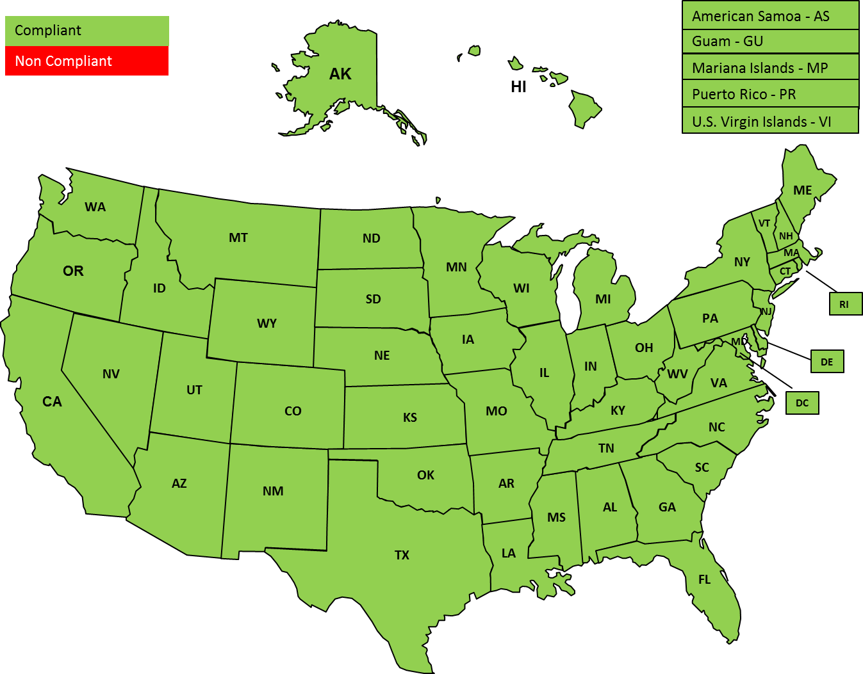
PL 113-146 - Veterans Access, Choice and Accountability Act of 2014
Section 702 Progress
As of November 2015, all 50 states, the District of Columbia, and 5 territories/commonwealths (AS, GU, MP, PR, VI) are fully compliant with section 702.
14

Slide 15
PL 113-146 - Veterans Access, Choice and Accountability Act of 2014
(Sec. 702 Funding)
Section 702 Funding
Reprogrammed funding for system updates to:
  Implement legislative requirements directed by the Choice Act (e.g. allow VA to disapprove institutions that charge Veterans out-of-state rate)
  Improve security and systems integration to enhance the user’s experience, provide flexibility and capability to report and capture program-level information
  Improve business analytics and reporting capabilities to understand various drivers of performance, their relationship to future outcomes, and improve decision-making for key stakeholders
  Systems impacted include:
    Benefits Delivery Network (BDN)
    Electronic Certification Automated Processing (ECAP)
    Long Term Solution (LTS)
    Veterans Online Certification of Enrollment System (VA-ONCE)
    Veterans Online Application Direct Connect System (VONAPP-VDC)
    Web-Enabled Approval Management System (WEAMS)
15

Slide 16
Reserve Educational Assistance Program (REAP)
  The National Defense Authorization Act of 2016 ended REAP on November 25, 2015, for new school enrollments.
  Due to Congressional mandate, VA can only grant REAP eligibility to those enrolled in school on November 24, 2015, or during their school’s last term, quarter, or semester ending prior to that date.
  This change affects beneficiaries differently:
      Current REAP beneficiaries -- Veterans who were attending an educational institution on Nov. 24, 2015, or during the last semester, quarter, or term ending prior to that date, are eligible to continue to receive REAP benefits until November 25, 2019.
        3,500 beneficiaries were enrolled in school on November 24, 2015.
  REAP beneficiaries not attending school -- Veterans who previously applied for REAP but were not attending an educational institution on November 24, 2015, or during the last semester, quarter, or term ending prior to that date are no longer eligible to receive REAP benefits.
    VA notified affected Veterans who previously applied for REAP benefits of this change and their potential eligibility for other VA educational assistance programs.
  New REAP applicants – Veterans who have not enrolled in school and applied for REAP benefits prior to November 25, 2015, are no longer eligible for REAP benefits.
16

Slide 17
Reserve Educational Assistance Program (REAP) cont.
  He or she may still be eligible for Post-9/11 GI Bill benefits, depending on the individual’s dates of service.
    There are approximately 6,500 beneficiaries with service dates on or after August 1, 2011, who did not have any prior service. Same-period service rules apply to anyone with service dates on or after August 11, 2011, which may impact eligibility for another education program.
  VA will evaluate all applications for REAP received on or after November 25, 2015, to determine eligibility for another program, including the Post-9/11 GI Bill, and will award benefits under a different program if found eligible.
  As of May 13, 2016, VA identified 72 cases that were not found eligible for REAP.
    34 did not retain eligibility due to the REAP sunset provision.
    38 were not eligible regardless of the REAP sunset.
17

Slide 18
Enforcement Challenges
  For-Profit Task Force
    Led by Department of Education
    Forum for federal agency communication and coordination
    Congressional Interest
  University of Phoenix – DoD Action
  Education Management Corporation (EDMC) - DOJ settlement
  DeVry Institute – FTC Suit
18

Slide 19
Legislation Introduced in the 114th Congress
  H.R. 3016, the “Veterans Employment, Education, and Healthcare Improvement Act.” [Bill passed by the House on February 9, 2016]
    Clarifies eligibility for the Marine Gunnery Sergeant John David Fry Scholarship
    Allows Fry Scholarship recipients to participate in the Yellow Ribbon program
    Recodifies and improves benefit election process
    Codifies SAA role in determining “deemed approved”
    Clarifies criteria used to approve courses
    Amends compliance survey criteria
    Requires VA to provide info on Veteran entitlement to schools
    Requires VA survey individuals who are using or have used VA benefits
19
Notes:
Clarifies eligibility for the Marine Gunnery Sergeant John David Fry Scholarship
New provision – no official VA position
Allows Fry Scholarship recipients to participate in the Yellow Ribbon program
VA does not object, subject to Congress identifying acceptable offsets for the additional benefit costs
Recodifies and improves benefit election process
Support – have concerns with authority to make alternative election
Codifies SAA role in determining “deemed approved”
Support – believe VA and the SAA should have approval authority
Clarifies criteria used to approve courses
Agree with intent – do not believe VA should be interjected into the SAA approval requirements
Amends compliance survey criteria
Support
Requires VA to provide info on Veteran entitlement to schools
Support the intent
Requires VA survey individuals who are using or have used VA benefits
Support the intent

Slide 20
Legislation Introduced in the 114th Congress (cont.)
  H.R. 3016 (cont.)
    Centralized reporting of enrollments by certain groups, districts, and consortiums
    Clarifies definition of covered individual from Choice Act to include Transferal of Active Duty
    Modifies characterization of certain service for Reservists so time spent receiving medical care is creditable
    Restores expired authority for certain work study activities
    Modifies benefits transferred to family member under the Post- 9/11 GI Bill*
    Caps certain flight training and other programs of education*
    Authorized $30M to “finish” automation of claims processing*
*Not included in the Senate Omnibus Bill
20
Notes:
Centralized reporting of enrollments by certain groups, districts, and consortiums
Support
Clarifies definition of covered individual from Choice Act
Have concerns – expands eligibility to include dependents of Servicemembers
Modifies characterization of certain service for Reservists so time spent receiving medical care is creditable
Defer to DoD
Restores expired authority for certain work study activities
Do not oppose – subject to the identification of appropriate offsets
Modifies benefits transferred to family member under the
Post-9/11 GI Bill
Defer to DoD
Caps certain flight training and other programs of education
Support
Authorized $30M to “finish” automation of claims processing
Support

Slide 21

Legislation Introduced in the 114th Congress (cont.)
  Senate Omnibus Bill
    Clarifies eligibility for the Marine Gunnery Sergeant John David Fry Scholarship
    Allows Fry Scholarship recipients to participate in the Yellow Ribbon program
    Recodifies and improves benefit election process
    Codifies SAA role in determining “deemed approved”
    Clarifies criteria used to approve courses
    Amends compliance survey criteria
    Requires VA to provide info on Veteran entitlement to schools
    Requires VA survey individuals who are using or have used VA benefits
    Centralized reporting of enrollments by certain groups, districts, and consortiums
    Clarifies definition of covered individual from Choice Act to include Transferal of Active Duty
21
Notes:
Clarifies eligibility for the Marine Gunnery Sergeant John David Fry Scholarship
New provision – no official VA position
Allows Fry Scholarship recipients to participate in the Yellow Ribbon program
VA does not object, subject to Congress identifying acceptable offsets for the additional benefit costs
Recodifies and improves benefit election process
Do not object – have concerns with authority to make an alternative election
Restores expired authority for certain work-study activities
Do not oppose – subject to the identification of appropriate offsets
Centralized reporting of enrollments by certain groups, districts, and consortiums
Support
Requires VA to provide info on Veteran entitlement to schools
Support the intent
Codifies SAA role in determining “deemed approved”
Support – believes that both the Secretary and the SAA should have approval authority
Clarifies criteria used to approve courses
Agree with intent – does not believe VA should be interjected into the SAA approval requirements
Amends compliance survey criteria
Support
Requires VA survey individuals who are using or have used VA benefits
Support the intent
Clarifies definition of covered individual from Choice Act
Have concerns – expands eligibility to include dependents of Servicemembers

Slide 22
Legislation Introduced in the 114th Congress (cont.)
  Senate Omnibus Bill (cont.)
    Modifies characterization of certain service for Reservists so time spent receiving medical care is creditable
    Restores expired authority for certain work study activities
    Not included in H.R. 3016
    Assists individuals affected by permanent school closures
    Modifies characterization of certain service on active duty in the Reserve Components as active duty for Post-9/11 GI Bill eligibility
    Restores entitlement under the Montgomery GI Bill-Selected Reserve (MGIB-SR) for certain additional periods of active duty
    Assists individuals who lost REAP eligibility
    Requires educational institutions to submit annual report on academic progress to VA
    Modifies approval requirements for programs designed to prepare individuals for licensure or certification
    Reduces reporting fee rates
    Realigns housing allowance provided to VA beneficiaries
22
Notes:
Assists individuals affected by permanent school closures
Support
Modifies characterization of certain service on active duty in the Reserve Components as active duty for Post-9/11 GI Bill eligibility
Defer to DoD – includes two additional call-ups not previously seen by VA
Restores entitlement under the Montgomery GI Bill-Selected Reserve (MGIB-SR) for certain additional periods of active duty
Do not oppose
Assists individuals who lost REAP eligibility
New provision – no official VA position
Requires educational institutions to submit annual report on academic progress to VA
Do not object
Modifies approval requirements for programs designed to prepare individuals for licensure or certification
Support the intent
Reduces reporting fee rates
New provision – no official VA position
Realigns housing allowance provided to VA beneficiaries
New provision – no official VA position

Slide 23


Contact Us
WEBSITE: www.benefits.va.gov/gibill
FACEBOOK: www.facebook.com/gibillEducation
TELEPHONE: 1-888-GIBILL-1 (1-888-442-4551)
23

